Slide 2
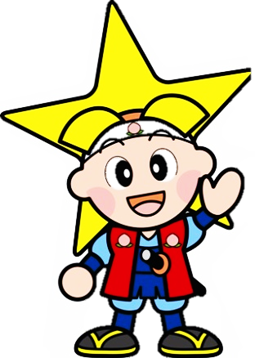
Okayama prefecture
7,112km²
=1.9million
Notes:
Okayama Prefecture has approximately 1.9 million people within it’s 7,112 square kilometer area. It is a fairly small town type of area, with much agriculture. It’s most popular theme surrounds the story of Momotarou, the Peach Boy. Momotarou is thus the mascot of Okayama.

Slide 3
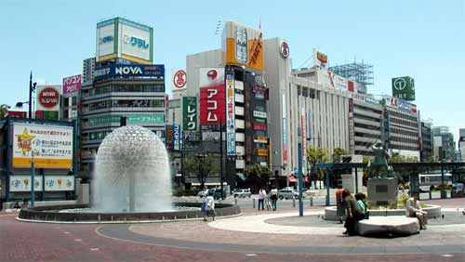
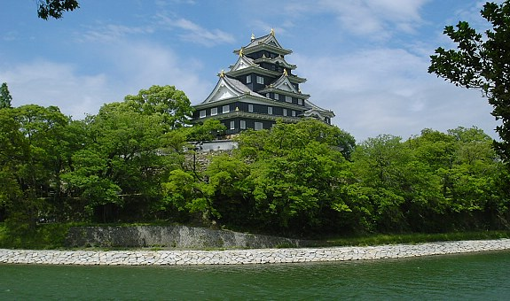
Okayama City
Capital of Okayama Prefecture
Castle Town – since 16th century
More than 700,000 in population
Easy to traverse, with bicycles, buses & trains
Notes:
Okayama City is small yet large, with many large scale companies. It started as a castle town in the 16th century and today stands as Okayama Prefecture’s capital city. It has a population of 700,000 people who are of a friendly nature. It is an easy to traverse area, with a lot of bicycles, buses and trains that are easily accessible.

Slide 4
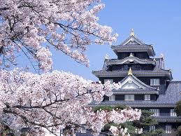
Place to go to / Things to do
Karaoke
Visit Ujo (Raven Castle)
Food
Sight-seeing place
Seasonal
Notes:
There are various places to go and things to do in Okayama City. There are many karaoke bars around, with large buildings set up to fill every floor with friends coming to hang out and sing. There is “Ujo” the raven castle, where one can get a beautiful view of the garden. The food in Okayama is fantastic, with one of its most popular dishes being okonomiyaki. There are also many sight-seeing locations, such as the castle, the garden the castle overlooks, and various other locales. It is also very seasonal, making every month a very different view for sight-seeing.

Slide 5
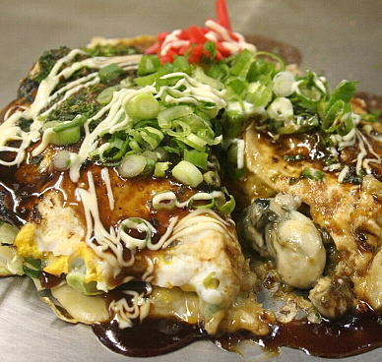
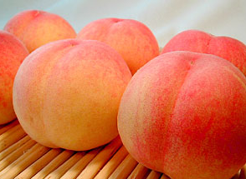
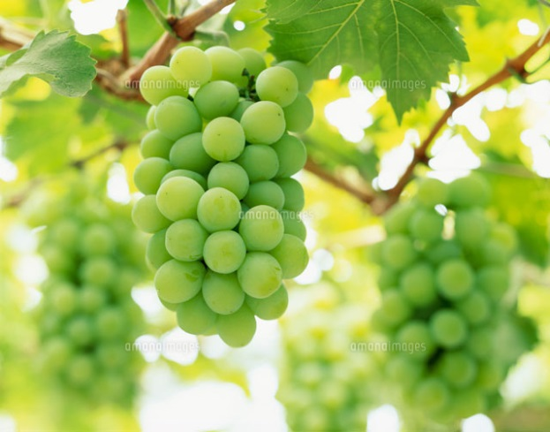
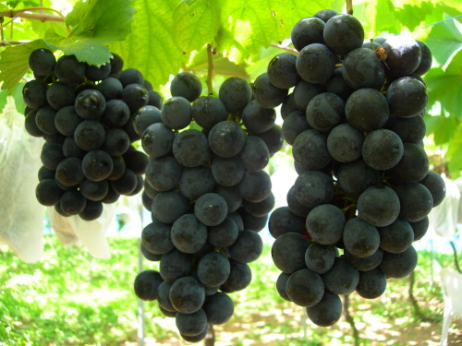
Food
Barazushi
Kaki-Oko ( Okonomiyaki with oyster)
A variety of fruits
Notes:
There is a delightful array of foods available. Some of the better known dishes are Barazushi and Kaki-Oko. Okayama is also known for its peaches and grapes, as well as other fruits.

Slide 6
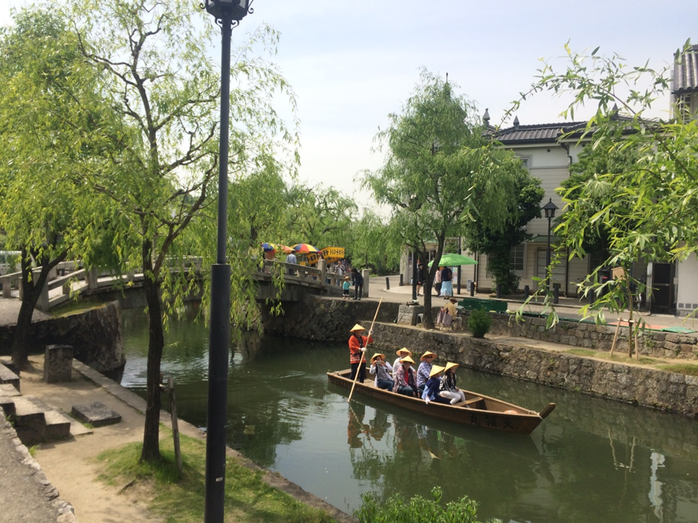
Sight-seeing place
Okayama Kourakuen
Kurashiki Bikanchiku
Notes:
Okayama Kourakuen, the garden the castle overlooks, is a beautiful sight and a worth while walk through the park. There is a lot of space to travel, koi fish in the pond, and various types of wildlife and plantlife to see.
Kurashiki Bikanchiku is also a beuatiful place. It is a great destination for sight-seeing.

Slide 7
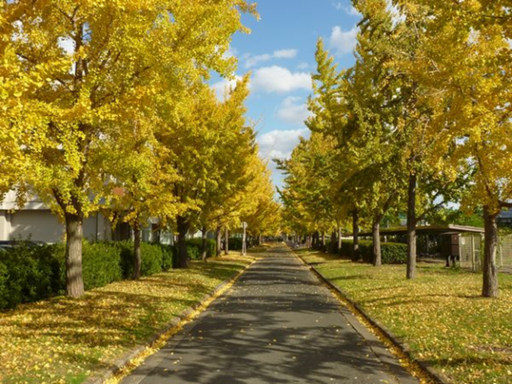
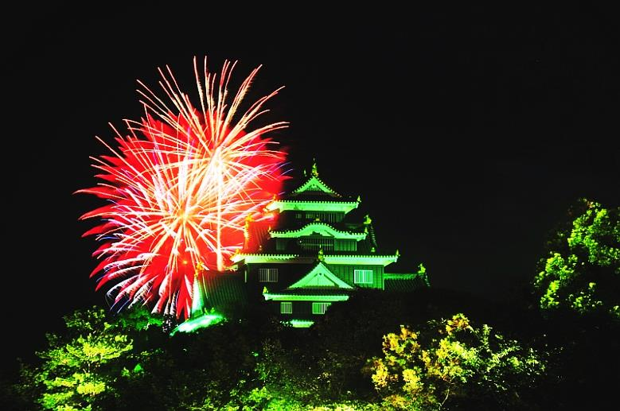
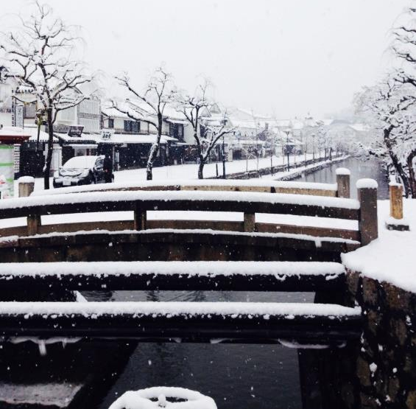
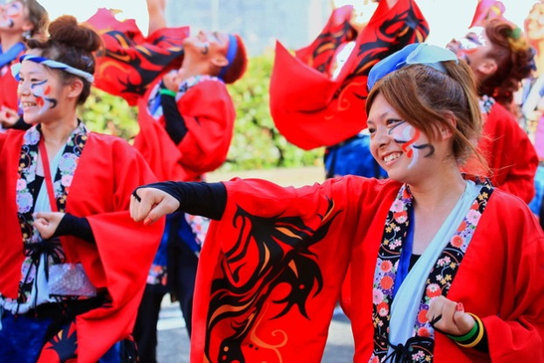
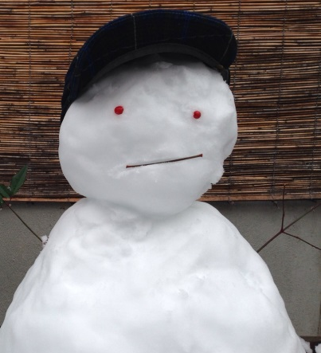
Seasonal Event
Cherry blossom
Fire works / Momotarou festival
School festival / autumn colors
A little snow in winter
Notes:
Okayama is very seasonal with its events. There are the cherry blossoms, whose trees can be found most everywhere. But there are many great places where the best pictures can be taken.
In the fall, the Momotarou festival lights up the sky near the castle with fireworks. Near the garden, one can find a string of booths selling local foods and toys for children.
There is some snow during the winter time, which makes for a delightful travelling season.

Slide 8
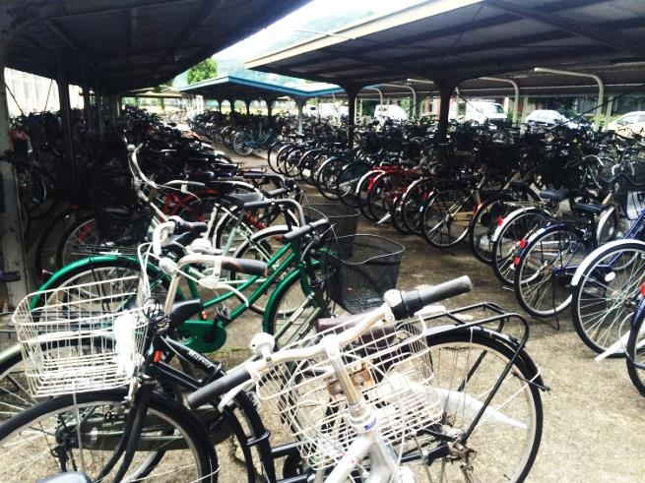
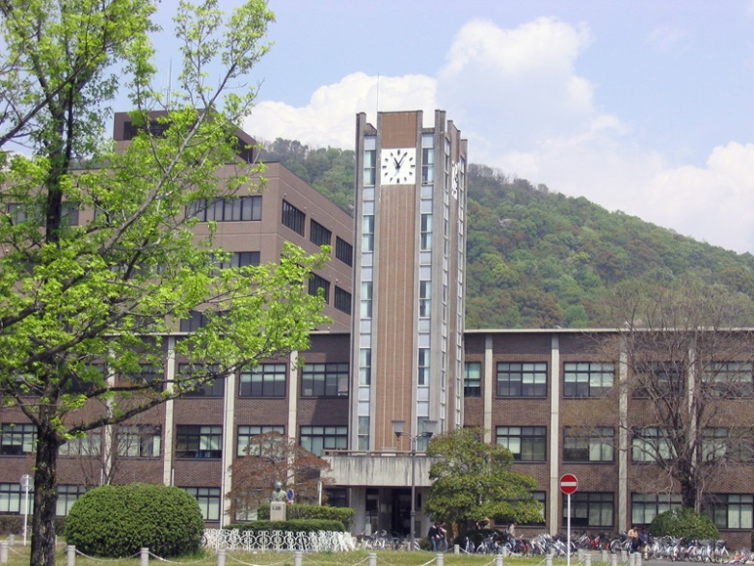
Daily life in Okayama University
The second largest national university in Japan
A number of Bicycles
Class
Cafeteria
L-café (Global activity)
Club activity
Notes:
Okayama University is the second largest national university in Japan. There are a number of bicycles used, as the location is so easy to traverse this way. Classes vary, from small to large groups of people. There are several cafeterias, all of which offer traditional Japanese meals.
On campus is found the L-cafe, a location that prides itself in globalizing the school’s community. Japanese students are invited in to speak various foreign languages with native speakers, while foreigners are invited in to speak Japanese. It is a great location for meeting new people and speaking different languages.
There are also various club activities available, ranging from kendo to horseback riding.

Slide 9
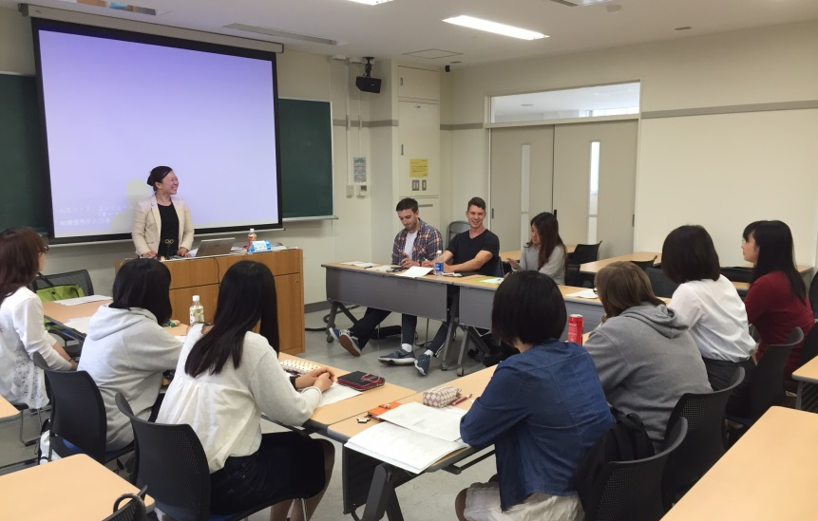
School life / Classes
Small class (seminar)
Large class (lecture)
Mixed class
(study with exchange students and Japanese
students) : Anthropology of Japan
Classes are simple but challenging
Notes:
Classes vary, from small seminar classes to large lecture classes. There are a lot of mixed classes available to foreign exchange students, which makes classes available to both foreign and Japanese students. One such example is Anthropology of Japan, taught by Professor Mayumi Ono.

Slide 10
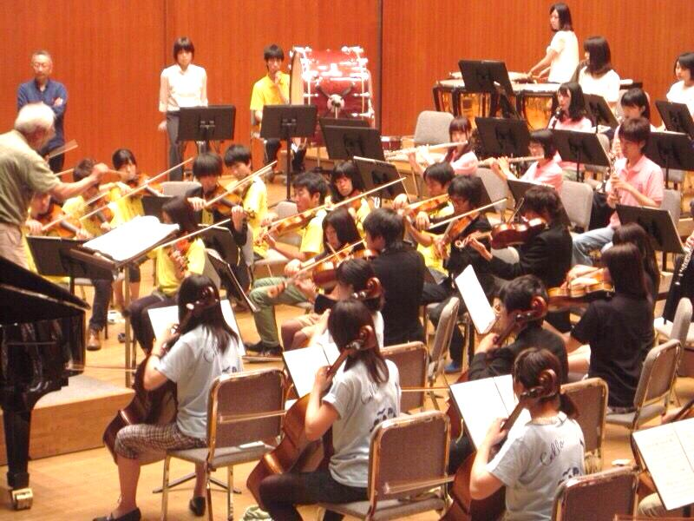
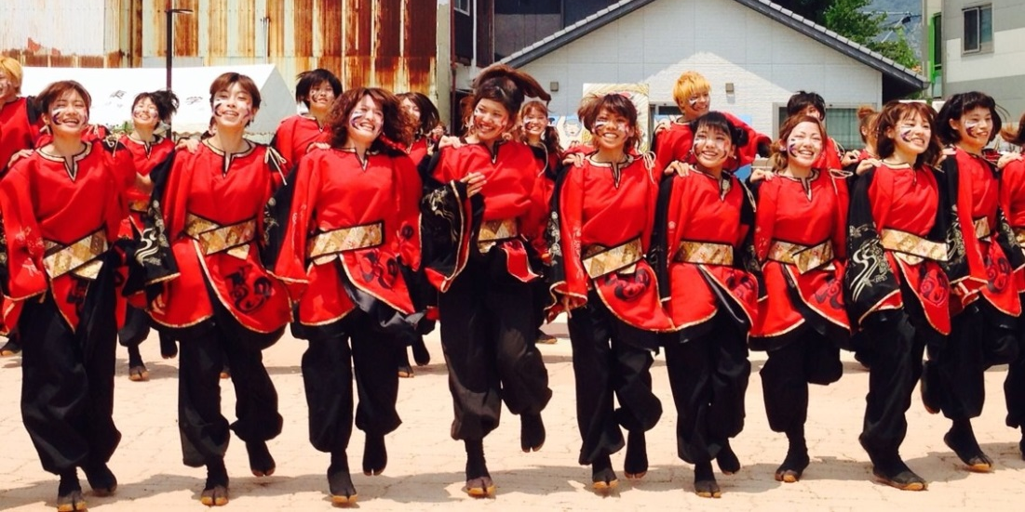
School life / Classes
Clubs
Orchestra
Kendo
Photography
Horseback Riding
Uraja
WAWA
Notes:
There are a variety of clubs, such as: orchstra, kendo, photography, horseback riding, uraja and WAWA.

Slide 11
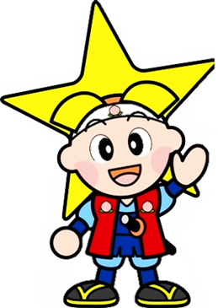
Thank you very much
for your attention!

Slide 12
My name is Maiko Ishii.
My faculty is Letters,
especially I’m studying linguistics.
I belonged Uraja club,
it’s traditional Okayama dance club!
Notes:
Maiko Ishii participated in spreading awareness of her school, Okayama University through this presentation.

Slide 13
Natsuki Takeuchi （竹内 奈津希）
Faculty : Literature
Major : English/American literature
Hobby :
1)Music
I love to sing, listen, play music (clarinet).
Recently I started to practice the guitar.
2)Watching sports
I like watching sports, especially soccer.
My favorite teams are Japan national team and Dortmund(Germany).
Notes:
Natsuki Takeuchi participated in spreading awareness of her school, Okayama University through this presentation.

Slide 14
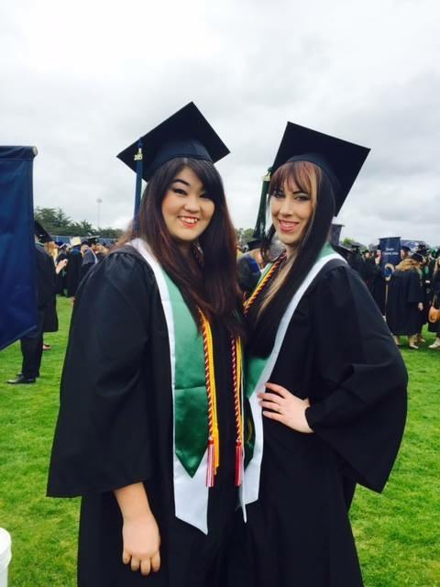
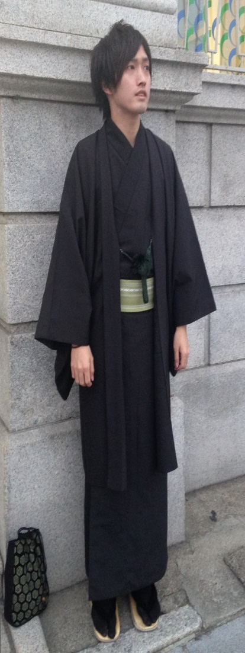
Kiyohiro Hirano (平野 陽大)
Major : Education
Hobby : Watching movies
Listening to music
Taylor and Shelby
Notes:
Kiyohiro Hirano participated in spreading awareness of his school, Okayama University through this presentation.

Slide 15
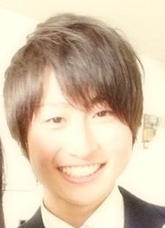
Shoki Yamaoka
・Second year student
・Major: Law
I like…
・Soccer
・Futsal
・Snowboard
And…eating!!
Notes:
Shoki Yamaoka participated in spreading awareness of his school, Okayama University through this presentation.

Slide 16
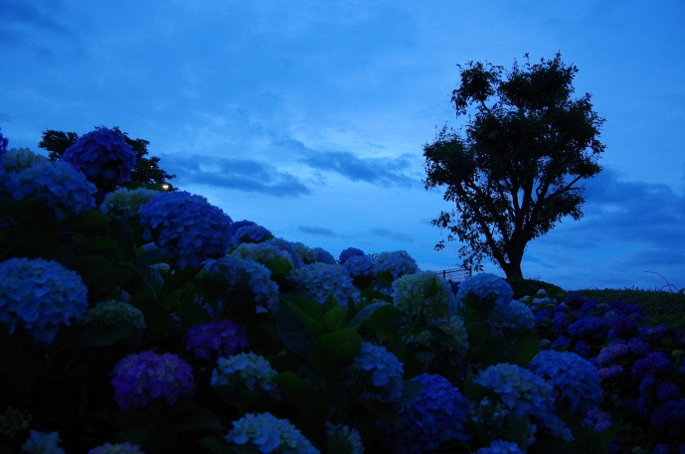
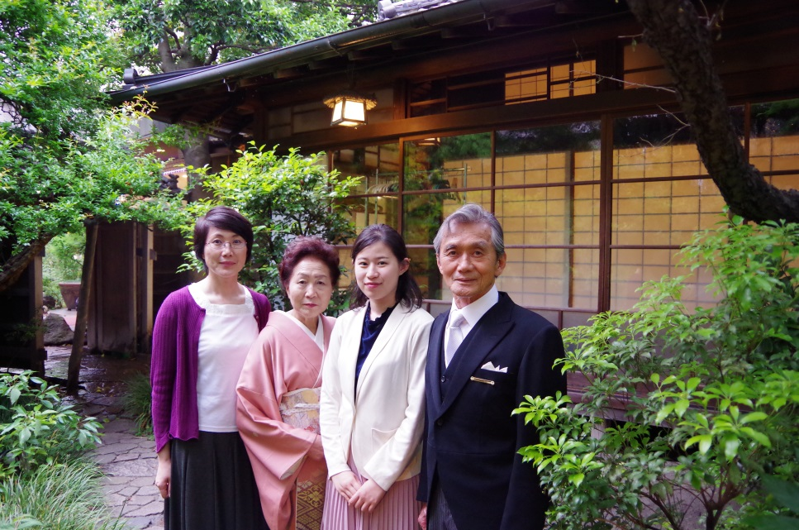
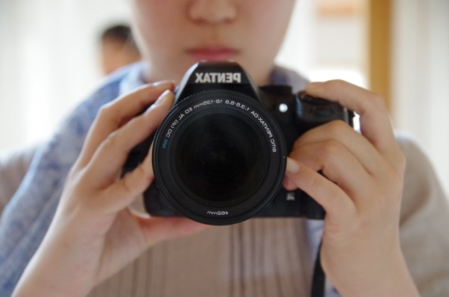
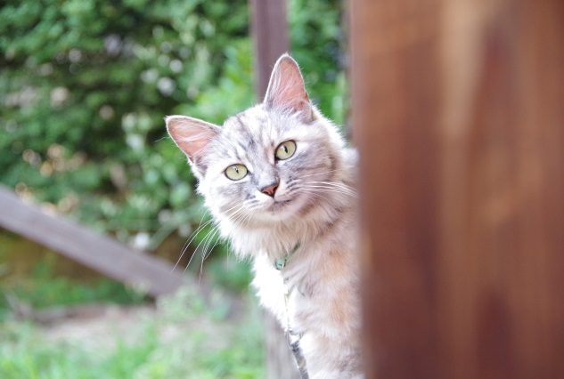
I’m sorry that I can’t speak for the care of acute tonsillitis (急性扁桃炎）
Chisato KUWAZONO
Age 21
Economics
In my free time…
travel, pictures
↓Travel to OITA(Kyushu)
↓my family
↓camera and me
↓my pet
Notes:
Chisato Kuwazono participated in spreading awareness of her school, Okayama University through this presentation. Due to sickness she could not speak during the presentation, but helped to assemble it anyways.

